Slide 1
Web chatting application
yuvanshu
Roll number- 20001011083
I have made this chatting application by using following texhnologies:
HTML
CSS
JAVASCRIPT
NODE.JS
Socket.io

Slide 2
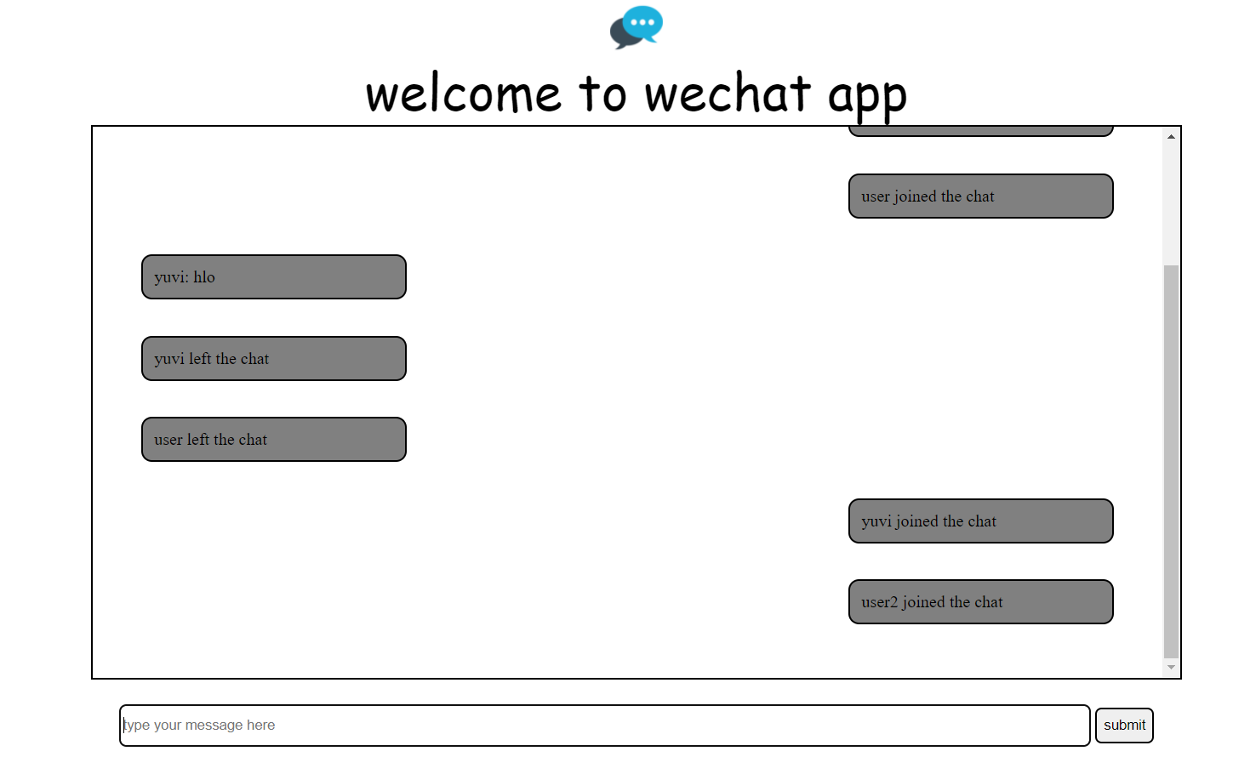
Ui of my application

Slide 3
In this application I have used HTML to write body of this application to allocate message sides and sending options , here is snapshot of my html code:
<!DOCTYPE html>
<html lang="en">
<head>
<meta charset="UTF-8">
<meta http-equiv="X-UA-Compatible" content="IE=edge">
<meta name="viewport" content="width=device-width, initial-scale=1.0">
<title>wechat- chat app</title>
<script defer src = "http://localhost:8000/socket.io/socket.io.js"></script>
<script defer src = "js/client.js"></script>
<link rel = "stylesheet" href ="css/style.css">
</head>
<body>
<nav>
<img class = "logo" src = "logo1.png" alt = " ">
</nav>
<div id = "header">
welcome to wechat app
</div>
<div class = "container">
<!--<div class = "message right">yuvi: hey how are you?</div>
<div class = "message left">rohan: bhai i am fine . what about you?</div>-->
</div>

Slide 4
<div class = "send">
<form action = "#" id = "send-container">
<input type = "text" name = "messageinp" placeholder="type your message here" id = "messageinp">
<!--<input type="file" name = "myfile" id = "file" accept="image/*">-->
<button class = "btn" type = "submit">submit</button>
</form>
</div>
</body>
</html>

Slide 5
Here I have used css to design its ui to have some attractive looks and for its responsiveness , is code is shown below:
.logo{
display: block;
margin: auto;
width: 50px;
height: 50px;
}
body{
background-color: rgb(rgba(255, 0, 0, 0.836), rgba(0, 128, 0, 0.733), rgba(0, 0, 255, 0.199));
}
#header{
text-align: center;
font-family: cursive;
font-size: 3rem;
}
.container{
max-width: 955px;
height: 60vh;
border: 2px solid black;
margin: auto;
padding: 33px;
overflow-y: auto;
margin-bottom: 23px;

Slide 6
}
.message{
background-color: grey;
width: 24%;
padding: 10px;
margin: 17px 12px;
border: 2px solid black;
border-radius: 10px;
}
.left{
float: left;
clear: both;
}
.right{
float: right;
clear: both;
}
#send-container{
text-align: center;
display: block;

Slide 7
margin: auto;
max-width: 985px;
width: 100%;
}
#messageinp{
width: 92%;
border: 2px solid black;
border-radius: 6px;
height: 34px;
}
.btn{
cursor: pointer;
border: 2px solid black;
border-radius: 6px;
height: 34px;
}

Slide 8
Then I download socket.io module via node js through npm for sending of messages .
then I created two servers:
1. client side
2. server side
I created these servers via node and connect both via sockets and javascript so that if client pulls or sends request to server it will reply immediately on every new event that are listed as various functions such as:
sending message
new connection
disconnection
Here below I have shown code of both client side and server side servers:

Slide 9
const socket = io('http://localhost:8000')
const form = document.getElementById('send-container')
const messageinput = document.getElementById('messageinp')
const messagecontainer = document.querySelector(".container")
var audio = new Audio('music.mp3');
const append = (message , position)=>{
const messageelement = document.createElement('div');
messageelement.innerText = message;
messageelement.classList.add('message')
messageelement.classList.add(position);
messagecontainer.append(messageelement);
if(position == 'left'){
audio.play();
}
}
form.addEventListener('submit' , (e)=>{
e.preventDefault();

Slide 10
const message = messageinput.value;
append(`You: ${message}`, 'right');
socket.emit('send' , message);
messageinput.value = '';
})
const name = prompt("enter your name to join");
socket.emit('new-user-joined' , name);
socket.on('user-joined', name=>{
append(`${name} joined the chat` , 'right')
})
socket.on('receive', data=>{
append(`${data.name}: ${data.message} ` , 'left')
})
socket.on('left' , name=>{
append(`${name} left the chat` , 'left')
})

Slide 11
//node server which will handle socket io connection
const io = require('socket.io')(8000,{
cors: {
origin: '*'
}
});
const users = {};
io.on('connection' , socket =>{
socket.on('new-user-joined' , name=>{
console.log("new user" , name)
users[socket.id] = name;
socket.broadcast.emit('user-joined' , name);
});
socket.on('send' , message=>{
socket.broadcast.emit('receive' , {message: message , name: users[socket.id]})
});
socket.on('disconnect' , message =>{
socket.broadcast.emit('left' , users[socket.id]);
delete users[socket.id];
});});

Slide 12
Here in this we receive notofications on our window of new user joining chat afer our joining and of disconnecting from chatbox via username joined the chat or username left the chat , the username here is that name which we input while joining chat also a ting sounds comes on every new message incoming and when any user lefts chat

Slide 13
Here is final snapshot of my application please have look:

Slide 14
